Slide 1
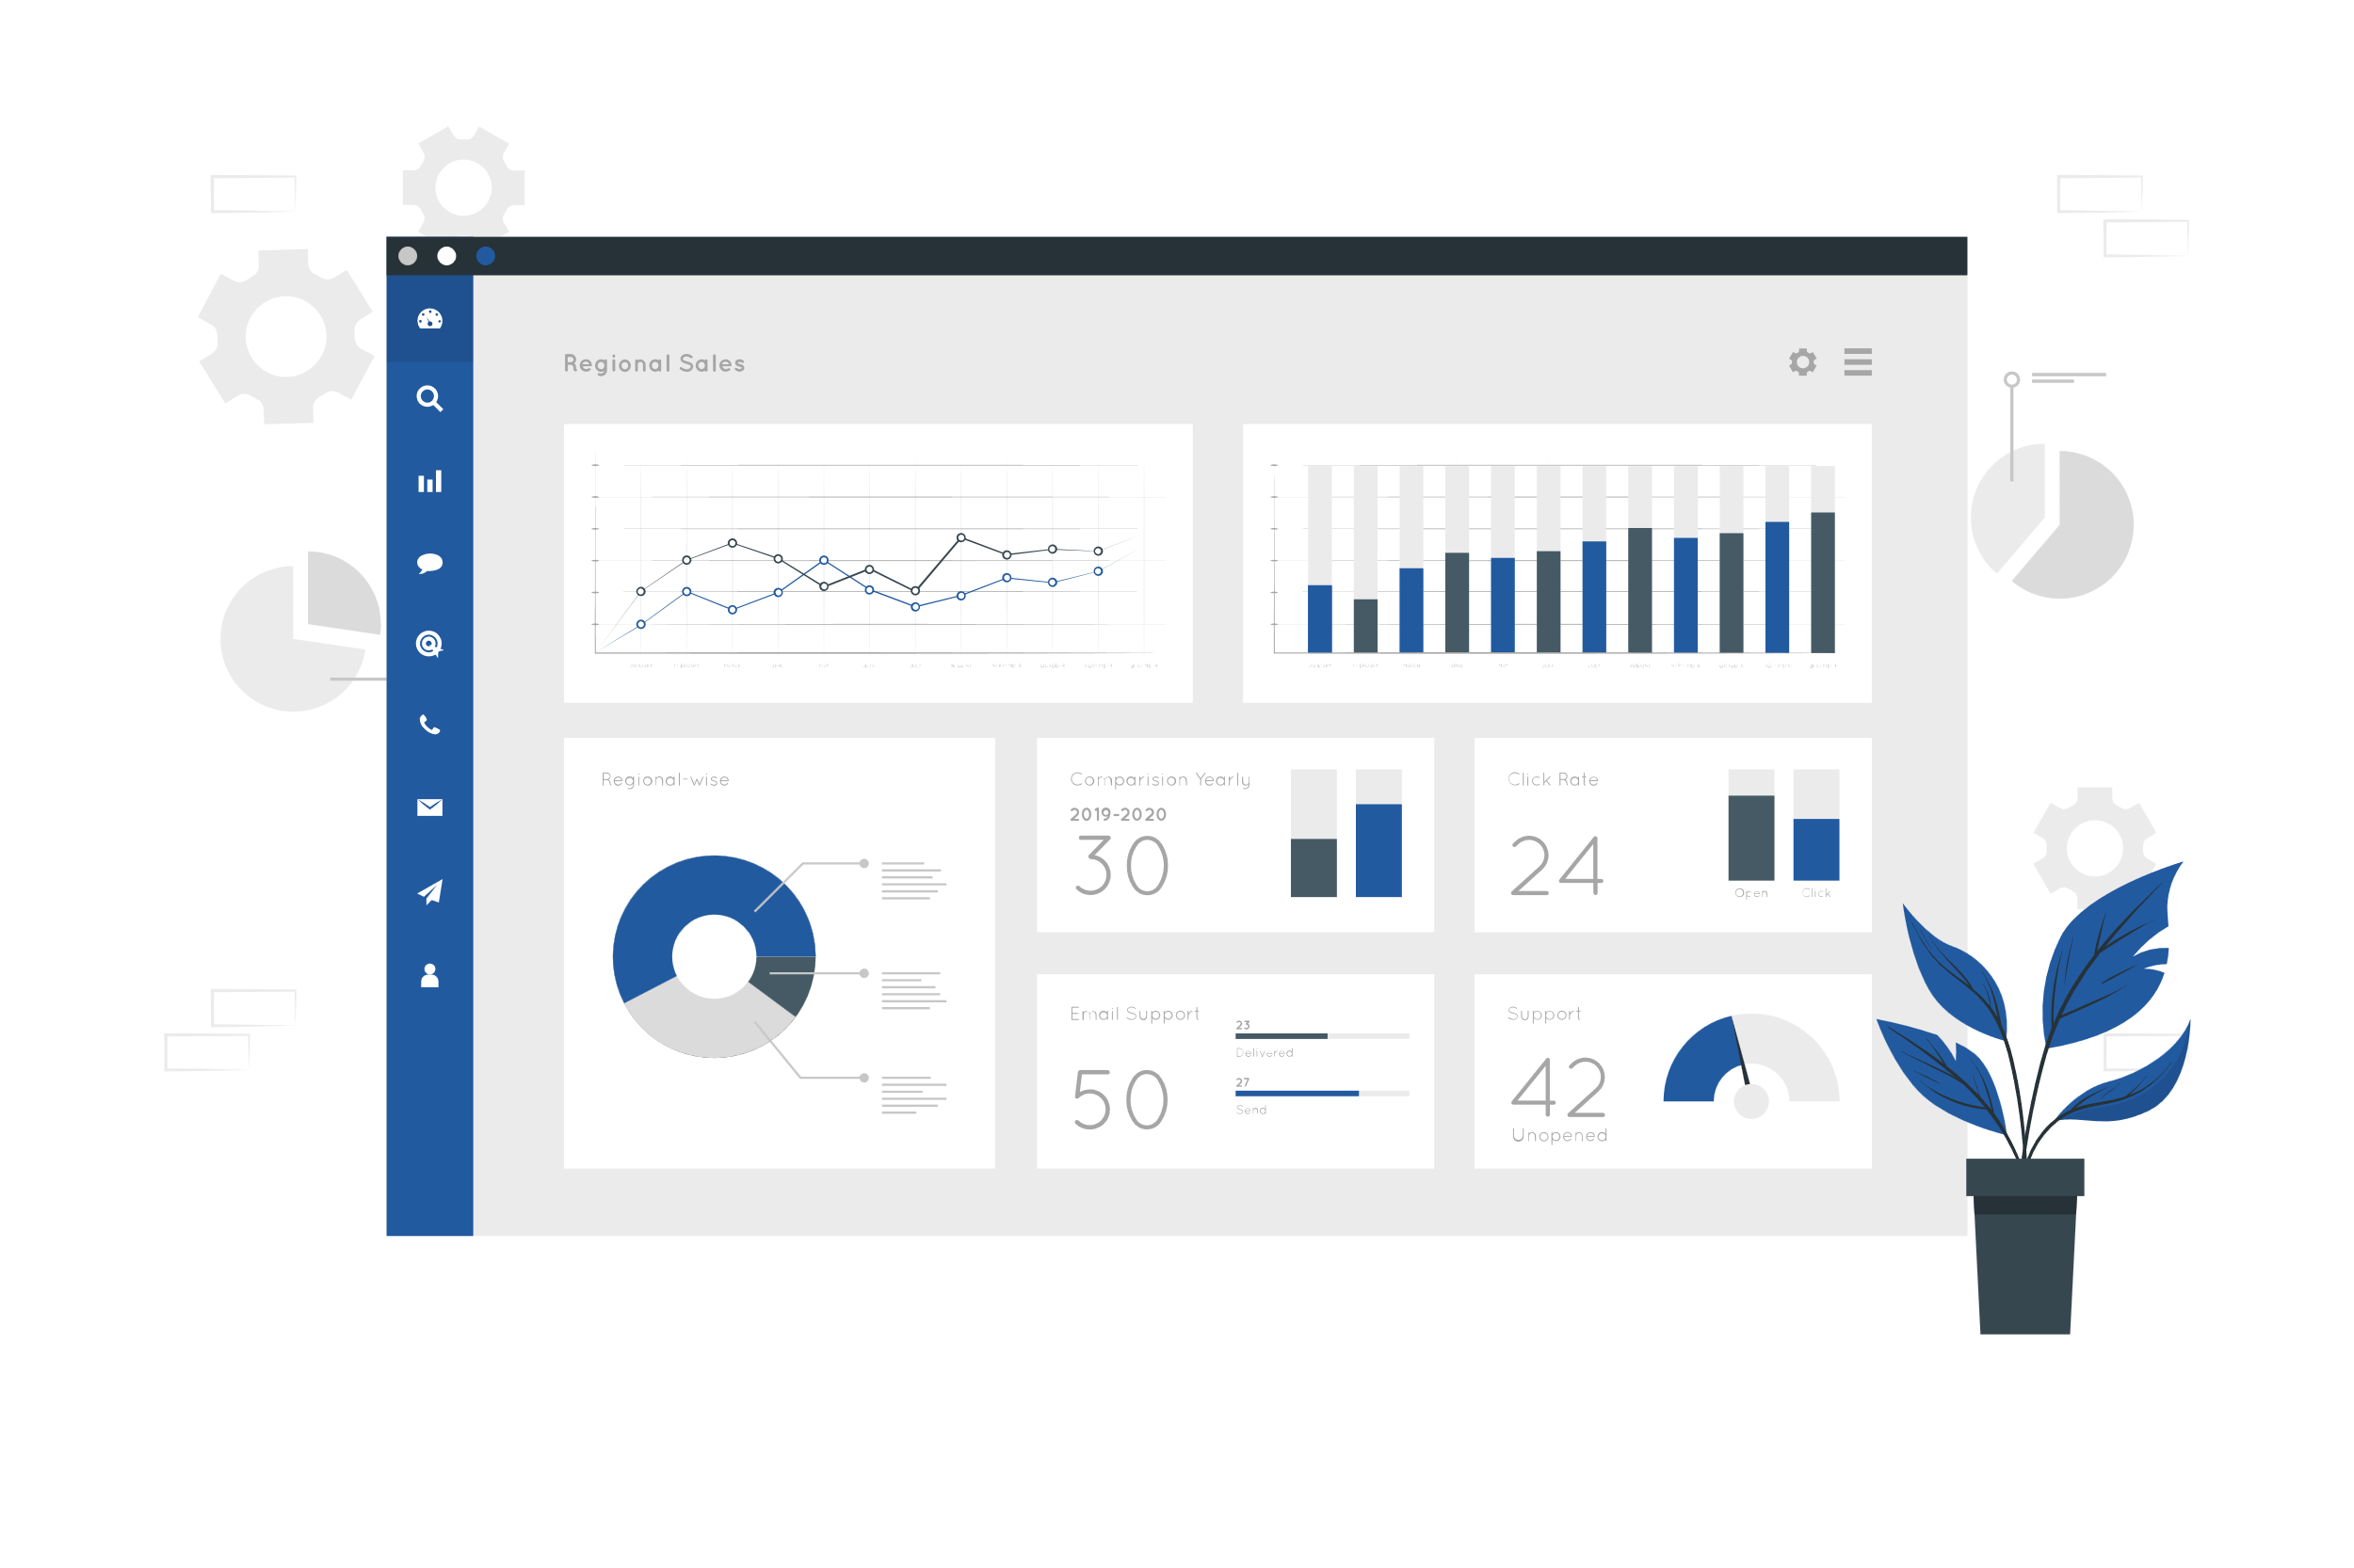
PowerBI PMO Dashboard
- Process Flow

Slide 2
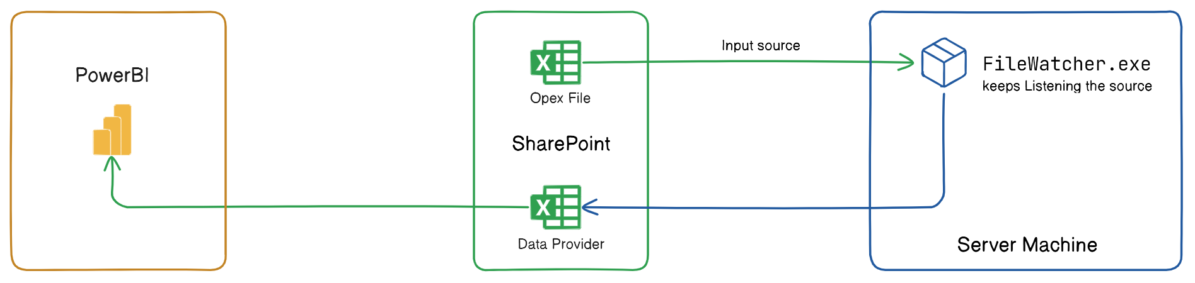
Process Flow Diagram

Slide 3
Thank You

